Slide 1


CANCER DETECTION USING CNN
CDAC DELHI
GROUP NUMBER : 10 (PG-DBDA)
GUIDE BY : Dr.Zeeshan Ahmed Khan
1) Rahul Wakalkar(220910125021)
2) Aarushi Sinha(220910125010)
3) Nishikant Nemade(220910125018)
4) Pankaj Kumar(220910125029)

Slide 2
CONTENT LAYOUT
CDAC DELHI
1.INTRODUCTION
2.EXECUTION
3.DATASET DESCRIPTION
4. DATASET
5.STEP OF PROJECT
6.WORKFLOW OF CNN
7.MODELLING DETAILS
8.MODEL TESTING
9.CONCLUSION
10.CHALLENGES FACED
11.SCOPE OF WORK
12.REFERENCES

Slide 3
INTRODUCTION
Normal cells follow a typical cycle: They grow, divide and die. Cancer cells, on the other hand, don't follow this cycle. Instead of dying, they multiply and continue to reproduce other abnormal cells. These cells can invade body parts, such as the breast, liver, lungs and pancreas. Cancer is second leading cause of death in the world.
Cancer is highly research area because there are so many people who suffer or die of cancerous disease.
This study aims to improve cancer detection in lymph nodes by using computer vision machine learning techniques.
We will examine the data to get a better understanding of it. Then, we will run multiple convolutional neural network models with the intent to be able to classify cancerous (1) and non-cancerous cells (0).With improved and faster cancer detection, patients will be able to receive life-saving treatments faster. This is the first step in those peoples survived from cancer.

Slide 4
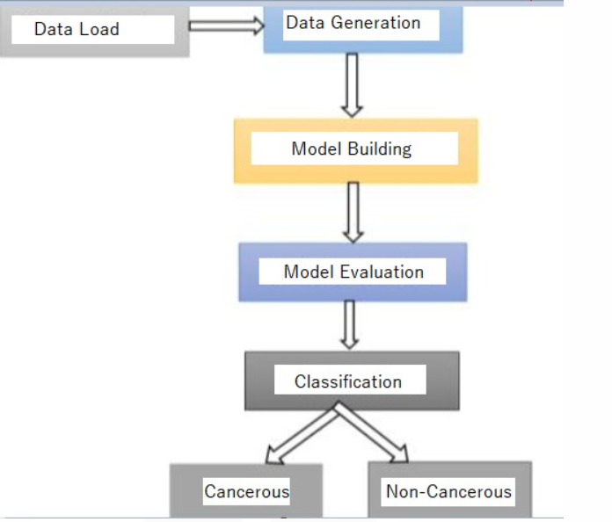
EXECUTION

Slide 5
DATASET DESCRIPTION
The dataset contains the histopathological Images, each image is 96px * 96px.
We have two datasets, a training and testing set already split. The training set contains 220,025 unique images and the test set contains about 57,500.
To use these images in a machine learning model, we are also given an identifying data frame with two columns: 'id' which is the unique image ID corresponding to the training directory, and 'label' which tells us the classification category.
Each label is either a 0 or 1, depending whether the image is non-cancerous (0) or cancerous (1)
We find that if at least one pixel of an image is identified as a cancerous then whole image is therefore marked with one otherwise it is 0.

Slide 6
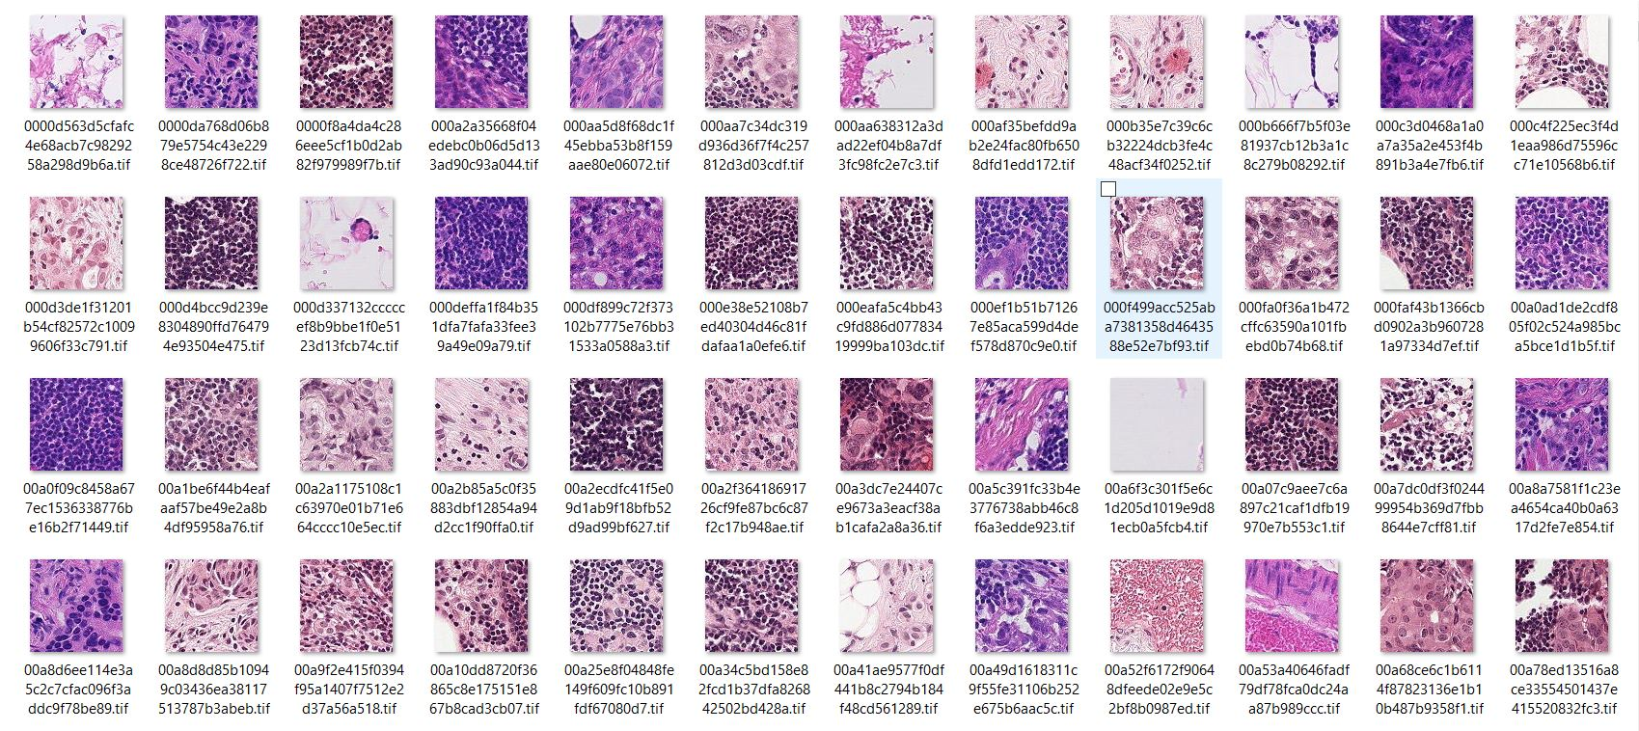
DATASET

Slide 7
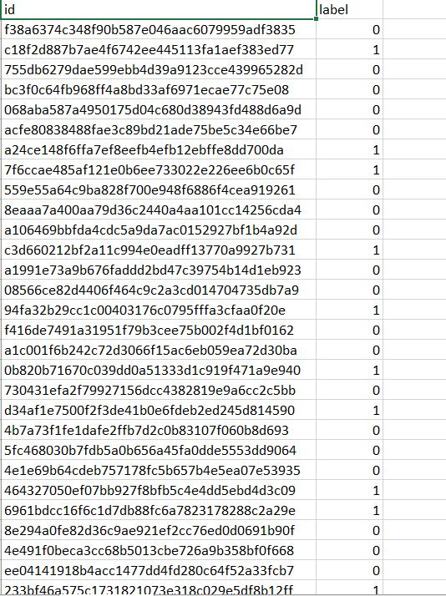
TRAIN DATA LABELING

Slide 8
STEPS OF PROJECT
Loading the dataset.
Find the dataset size.
Know the datatype of each attributes.
Visualize Data(EDA)

Slide 9
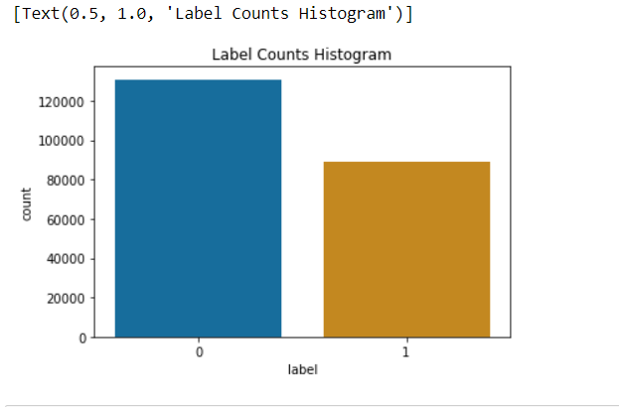
HISTOGRAM

Slide 10
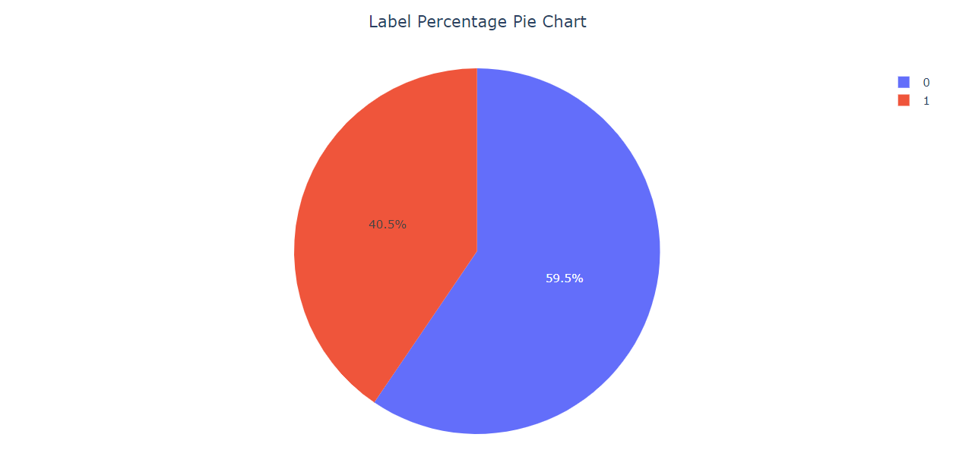
PIE CHART

Slide 11
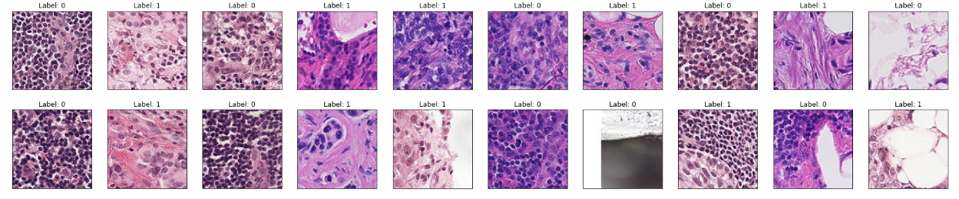
Visualize images are Cancerous(1) and Non-Cancerous(0) with 32x32 pixel image.

Slide 12
WORKFLOW OF CNN
Input image
Convolution layer(kernel)
Pooling layer
Classification – fully connected layer
Architecture

Slide 13
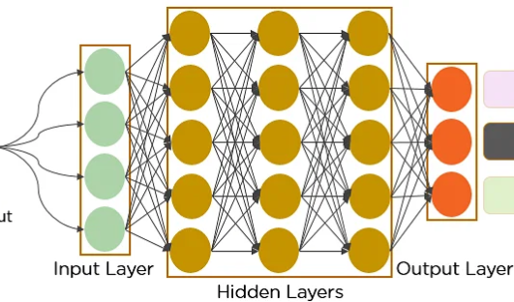

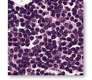
Convolution Neural Network is to Identify Histopathological images of
Cancerous or Non-Cancerous

Slide 14
MODELLING DETAILS
Normalization and Data Generation
Set up Graphics Processing unit(GPU)
Model Building
Output layer activation(Sigmoid function)
Optimization(Adam)
Learning Rate(0.0001)
Hidden layer Activation(ReLU function)
Dropout(0.3)

Slide 15
MODELLING DETAILS CONTINUED
Train model
Model Evaluation
Accuracy per epoch
Loss per epoch
ROC per epoch

Slide 16
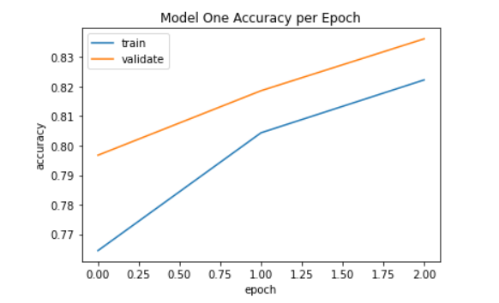
ACCURACY PER EPOCH

Slide 17
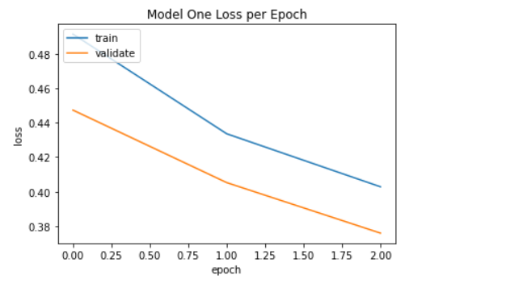
LOSS PER EPOCH

Slide 18
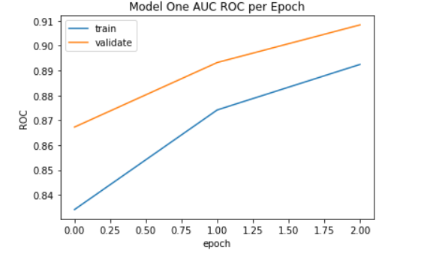
AUC ROC PER EPOCH

Slide 19
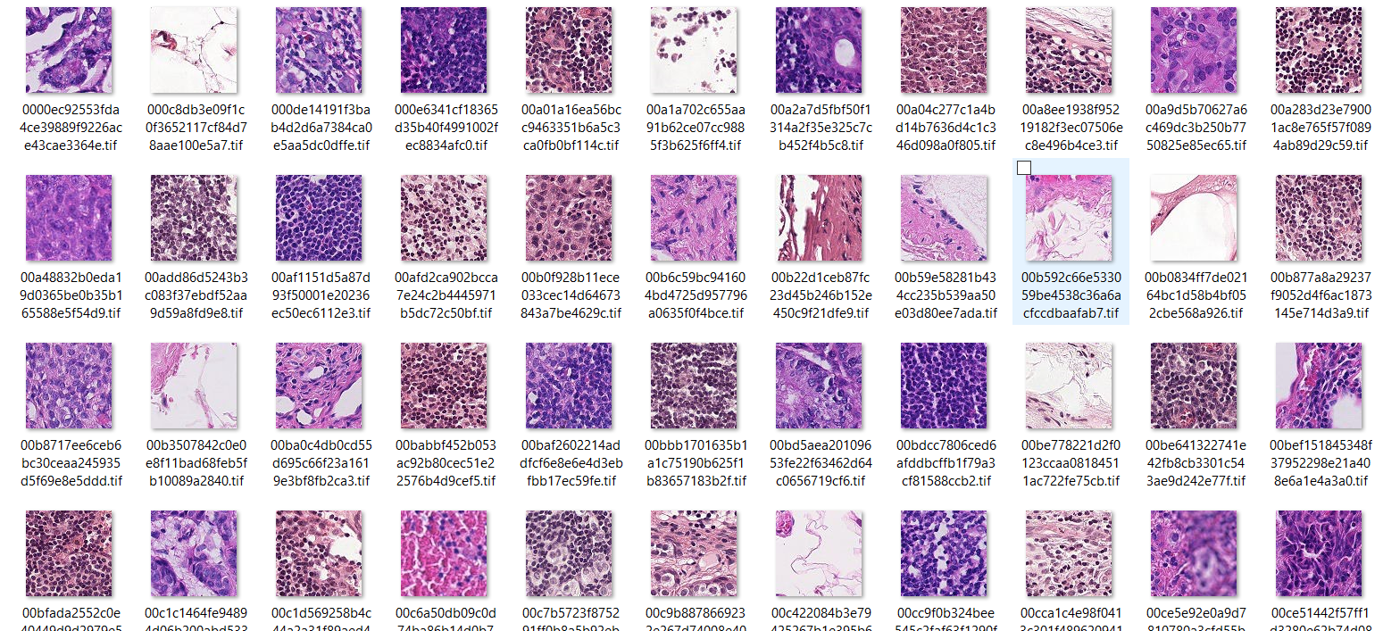
MODEL TESTING TEST DATA

Slide 20
TESTING DETAILS
create a data frame to run the predictions
prepare test data (in same way as train data)
run model to find predictions
create testing data frame
view test detection counts
plot test detections
Convert above output in csv format

Slide 21
CONCLUSION
The suggested classifier achieved good accuracy to identify risk of Cancer Detection
In this study, an efficient Deep learning based classification system has been developed for the
Classify cancerous or non-cancerous.

Slide 22
CHALLENGES FACED
Unable to extract images into features.
Could not reduce the time required to run the code

Slide 23
SCOPE OF WORK
As we know each body is different and exhibits different cancer symptoms every time. So each input data of all users are important in order to make the model more effective. In future we can use web application which is based upon deep learning model it takes user input and recognise is blood cell is cancerous or not.

Slide 24
REFERENCES
1.Edureka blogs and YouTube video
2.https://www.kaggle.com/
3.Analystics Vidhya
4.simplilearn
https://www.simplilearn.com/tutorials/deep-learning-tutorial/convolutional-neural-network/

Slide 25
THANK YOU
CDAC DELHI

